Slide 1
E-RPID Early Implementation Issues
Rob Quick
Science Gateways Research Center
Pervasive Technology Institute
10-September, 2019

Slide 2
The E-RPID Project

Slide 3
RPID and E-RPID NSF Work
RPID - Robust Persistent Identification of Data (NSF Grant No. 1659310)
March 2016-February 2018 ~$200k - IU/CNRI/Tufts
Set up initial RPID Handle and DTR Services (AWS and Bare Metal)
Success with initial use cases (more shortly)
ERPID - Enhanced RPID (Grant No. 1839013)
October 2018-September 2020 ~ $300k - IU/CNRI
Mapping Service, DOIP Testing, and Educational Materials
Services moved to Jetstream (OpenStack)
New use cases

Slide 4
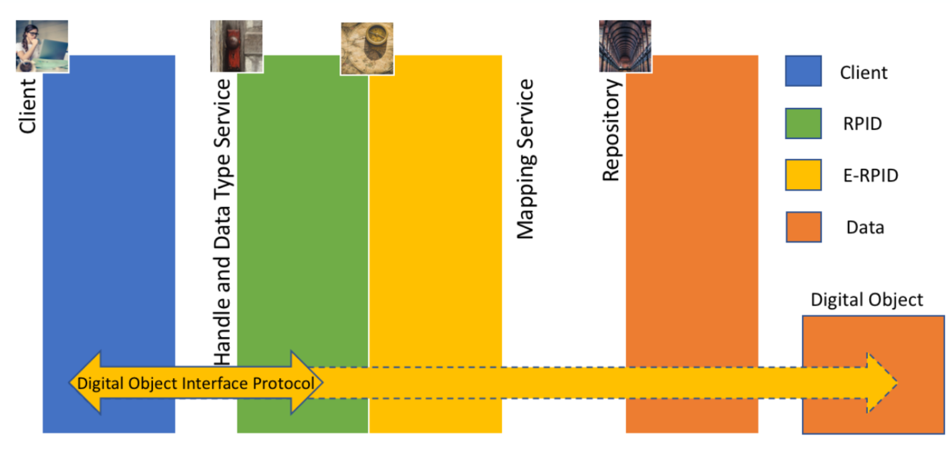
ERPID As Envisioned at start of Work

Slide 5
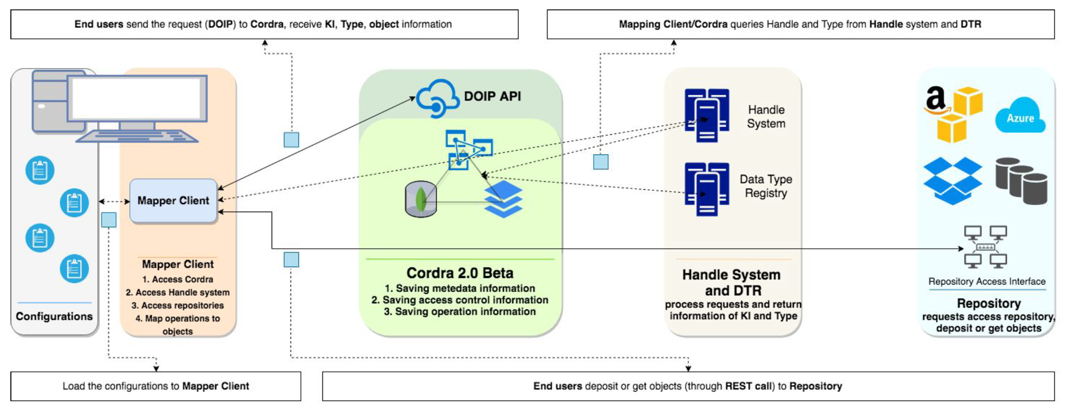
EPRID Architecture - In Reality

Slide 6
Diverse Use Cases
SEAD(Train)
PRAGMA Rice Genomics
CTS-URN
Jetsteam VMs
Science Gateways (SEAGrid)
Galaxy Bioinformatics Portal

Slide 7
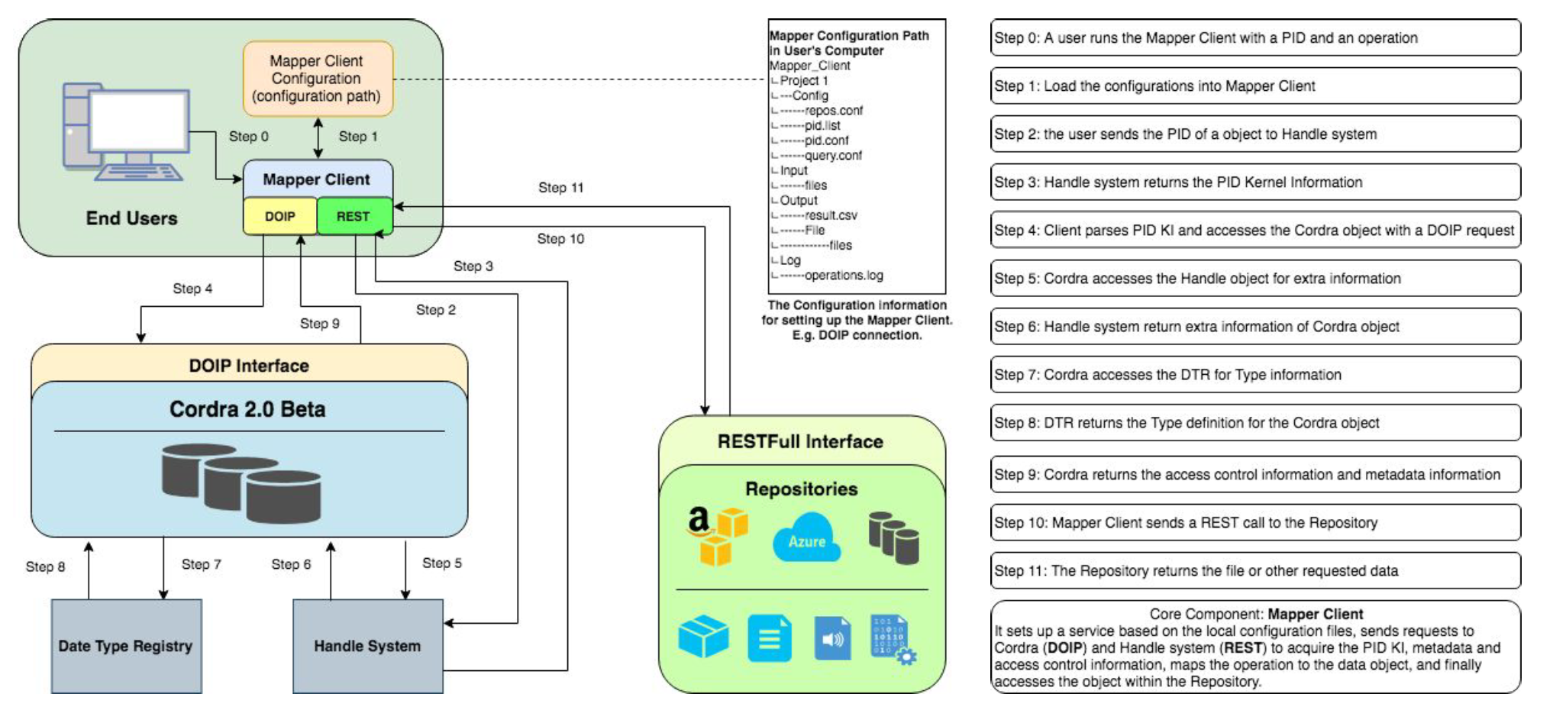
Sample Workflow

Slide 8
Early Implementation
Issues, Non-Issues, and Unknowns

Slide 9
Issues

Slide 10
Bug resolution
Upgrade to Cordra2 required implementation of new packages within Cordra software itself.
Some new packages were not available at the time of upgrade so Cordra development team provided work around options.
Good communication with Cordra developers have allowed these to only be minor issues.

Slide 11
AAI mechanisms (user registration to use API)
User registration is necessary to allow E-RPID mapper client to connect to Cordra2 instance via DOIP.
User registration will send a verification key.
Upon verification, access is granted for DOIP API implementation.
This extra level of authentication adds additional complexity. This will need to be eliminated along our path to wider adoption.

Slide 12
Only real testing has been from ‘insiders’
SEAD and SEAD Train developed a web portal that used RPID services for high-level filtering.
PRAGMA Rice Genomics, similar to SEAD Train.
CTS-URN - Proposed a solution to map CTS-URNs to Handles.
Jetstream VMs - Little additional value for very small data set of VMs.
SEAGrid - Work underway.
Galaxy Bioinformatics Portal - Work to begin in Y2 of E-RPID grant.

Slide 13
The “Testbed” Label
Educating Researchers
While there has been almost universal approval of the method, very few have moved to the adoption phase.
No effort to help with adoption outside of developing a mapping service.
Persistent IDs from RPID are not actually persistent.
We need success stories to motivate adoption.
Some basic educational materials will be produced as part of E-RPID, but Y1 effort has gone to moving services to OpenStack and developing the mapping service.

Slide 14
Non-Issues

Slide 15
Stability and Low-Maintenance Services
Initial RPID services were easy to install and deploy.
Little to no additional maintenance is necessary after basic operations mechanisms are in place.
In almost 3-years of the RPID Testbed there has been very little down time.
Operational issues we’ve observed have not been related to the service software.

Slide 16
Instantiating and moving services from AWS to Bare-metal to OpenStack
Move from bare-metal to OpenStack went smoothly.
Copy of the VM images was not possible due to the size limitations.
Both Cordra and handle software had to be reinstalled to the latest versions.
Configuration of new installation was straight forward.

Slide 17
Data Migration ease
Migration of data to the latest version of Cordra went smoothly.
We were not able to use export tools as data format used on the earlier version of Cordra was different from the new one.
Data was moved manually, new format is straightforward.
More time consuming than expected, no functionality issues were encountered.

Slide 18
Unknowns

Slide 19
Reusability of software libraries with E-RPID services
The packages/libraries for most used repositories are provided by their vendors or 3rd party development teams.
E-RPID services are expected to be integrated with existing libraries to be able to work with different sets of repositories (AWS, Azure, Git, DSpace, etc.)
Compatibility and ease of implementation is uncertain.

Slide 20
Will Typing work as we envision it?
Unknown unknowns
Issues related to scaling and federation of services.
Unknowns issues related to wide adoption.

Slide 21
https://rpidproject.github.io/rpid/
rquick@iu.edu
Thank You

